Slide 1
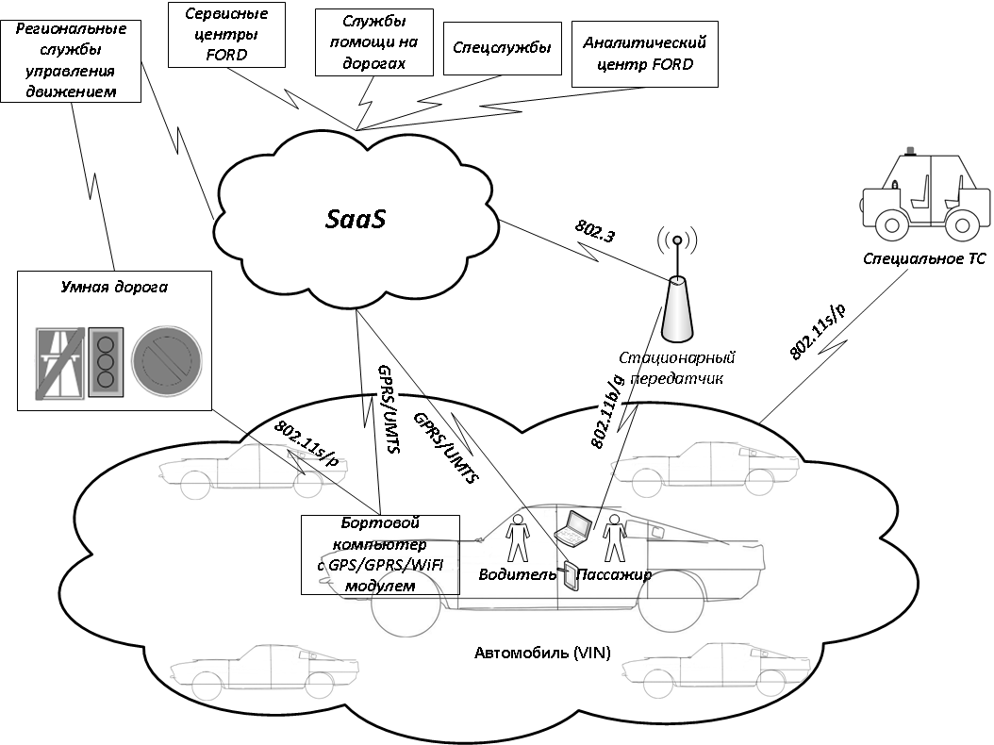
Абоненты информационных услуг и каналы передачи данных

Slide 2
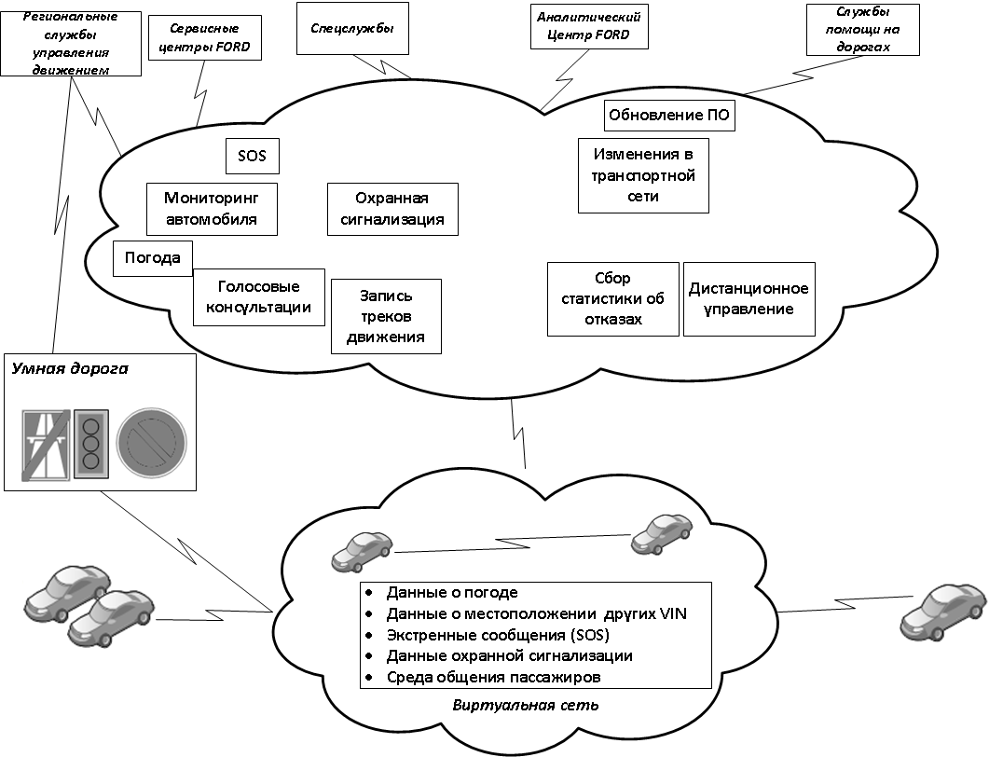
Облачные сервисы для абонентов FORD

Slide 3
Interaction of the P2P heterogenous network agents
with cloud environment
Cloud environment (SaaS)
Connection types:
- vehicle – vehicle
- cloud – vehicle
- vehicle - cloud
Traffic types:
simple messages
stream data
Data
Storage
Service 3
Service 4
Service N
Service 2
Communication
environment
VANET2
Service 1
VANET1
VANETn

Slide 4
Model of interaction between the MESH and the cloud
ns-3
Models
WiFi, TCP IP, 802.11s (MESH),
mobility models, traffic models,
environment model
Configuration
Object attributes, values,
random distributions
Execution
Experiment planning, scheduler
Analysis,
statistics
Optimal network parameters, protocols optimization

